Slide 1

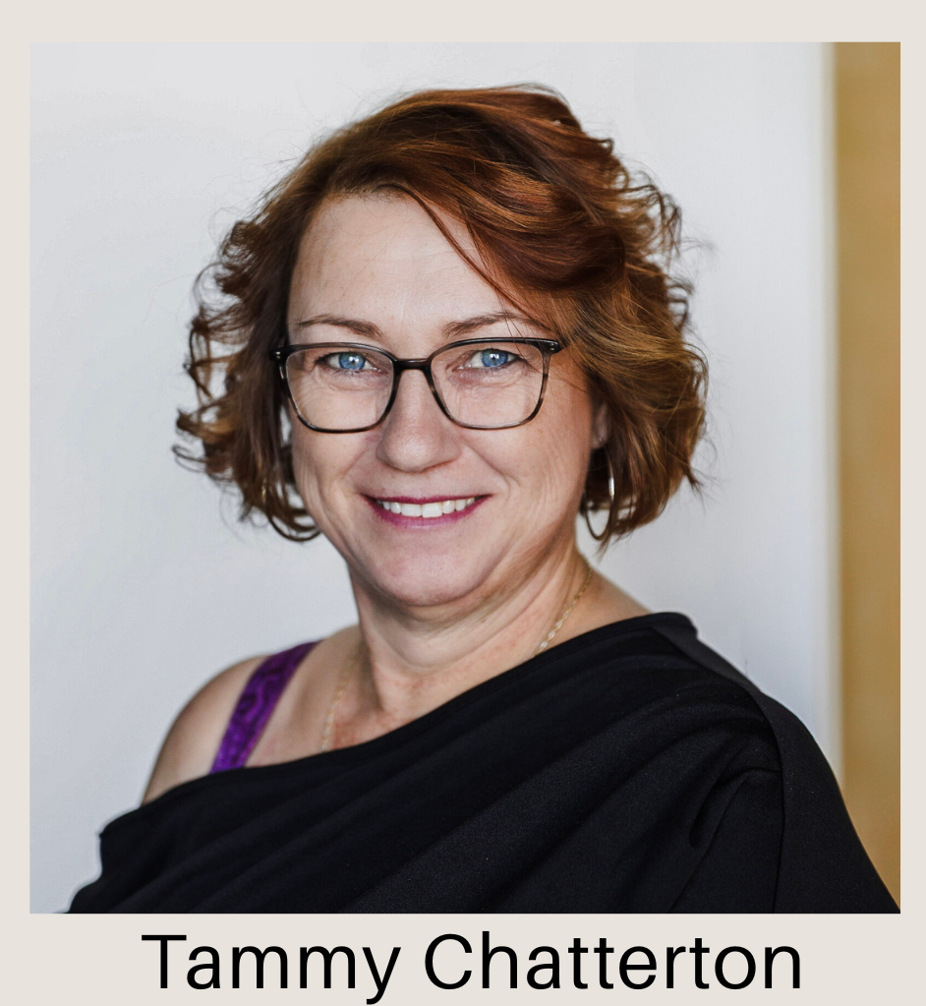





CASA’S
CELI TEAM
GASPÉ COAST

Slide 2


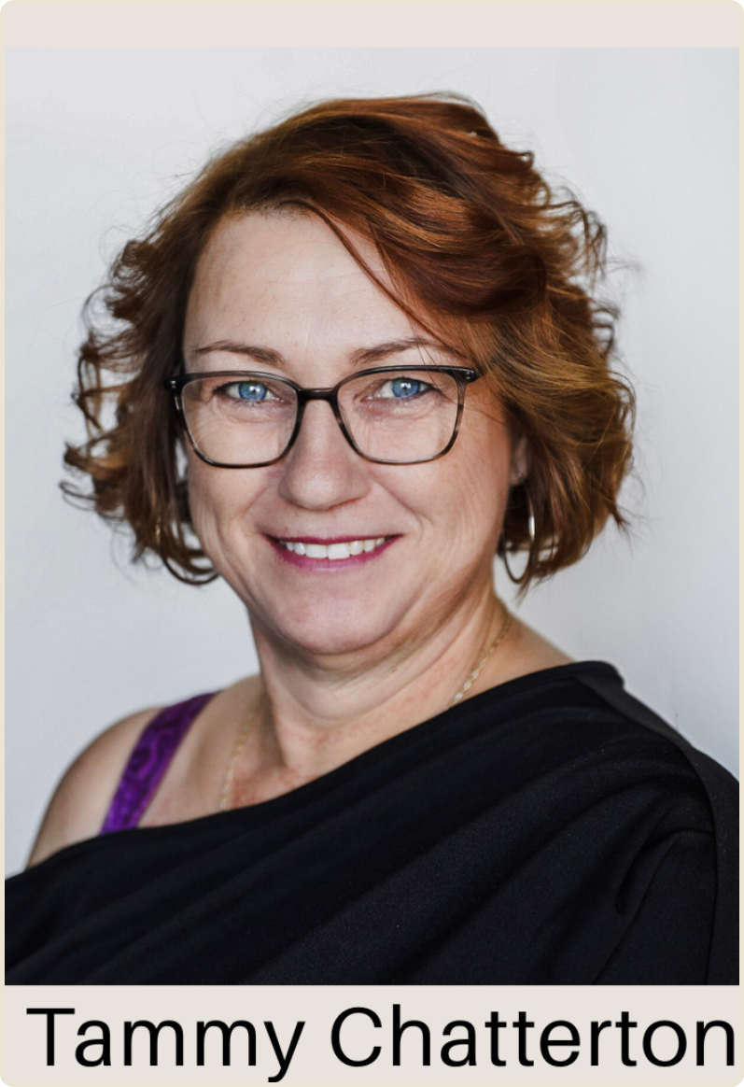
WHO WE ARE
We are CELI Coordinators working directly in our communities, supporting English-speaking adults as they navigate employment, training, and community connection
OUR ROLE:
COMMUNITY OUTREACH & ENGAGEMENT
SUPPORTING ADULTS AGED 16–60
DESIGNING AND DELIVERING LOCAL PROJECTS
BUILDING PARTNERSHIPS ACROSS SECTORS

Slide 3

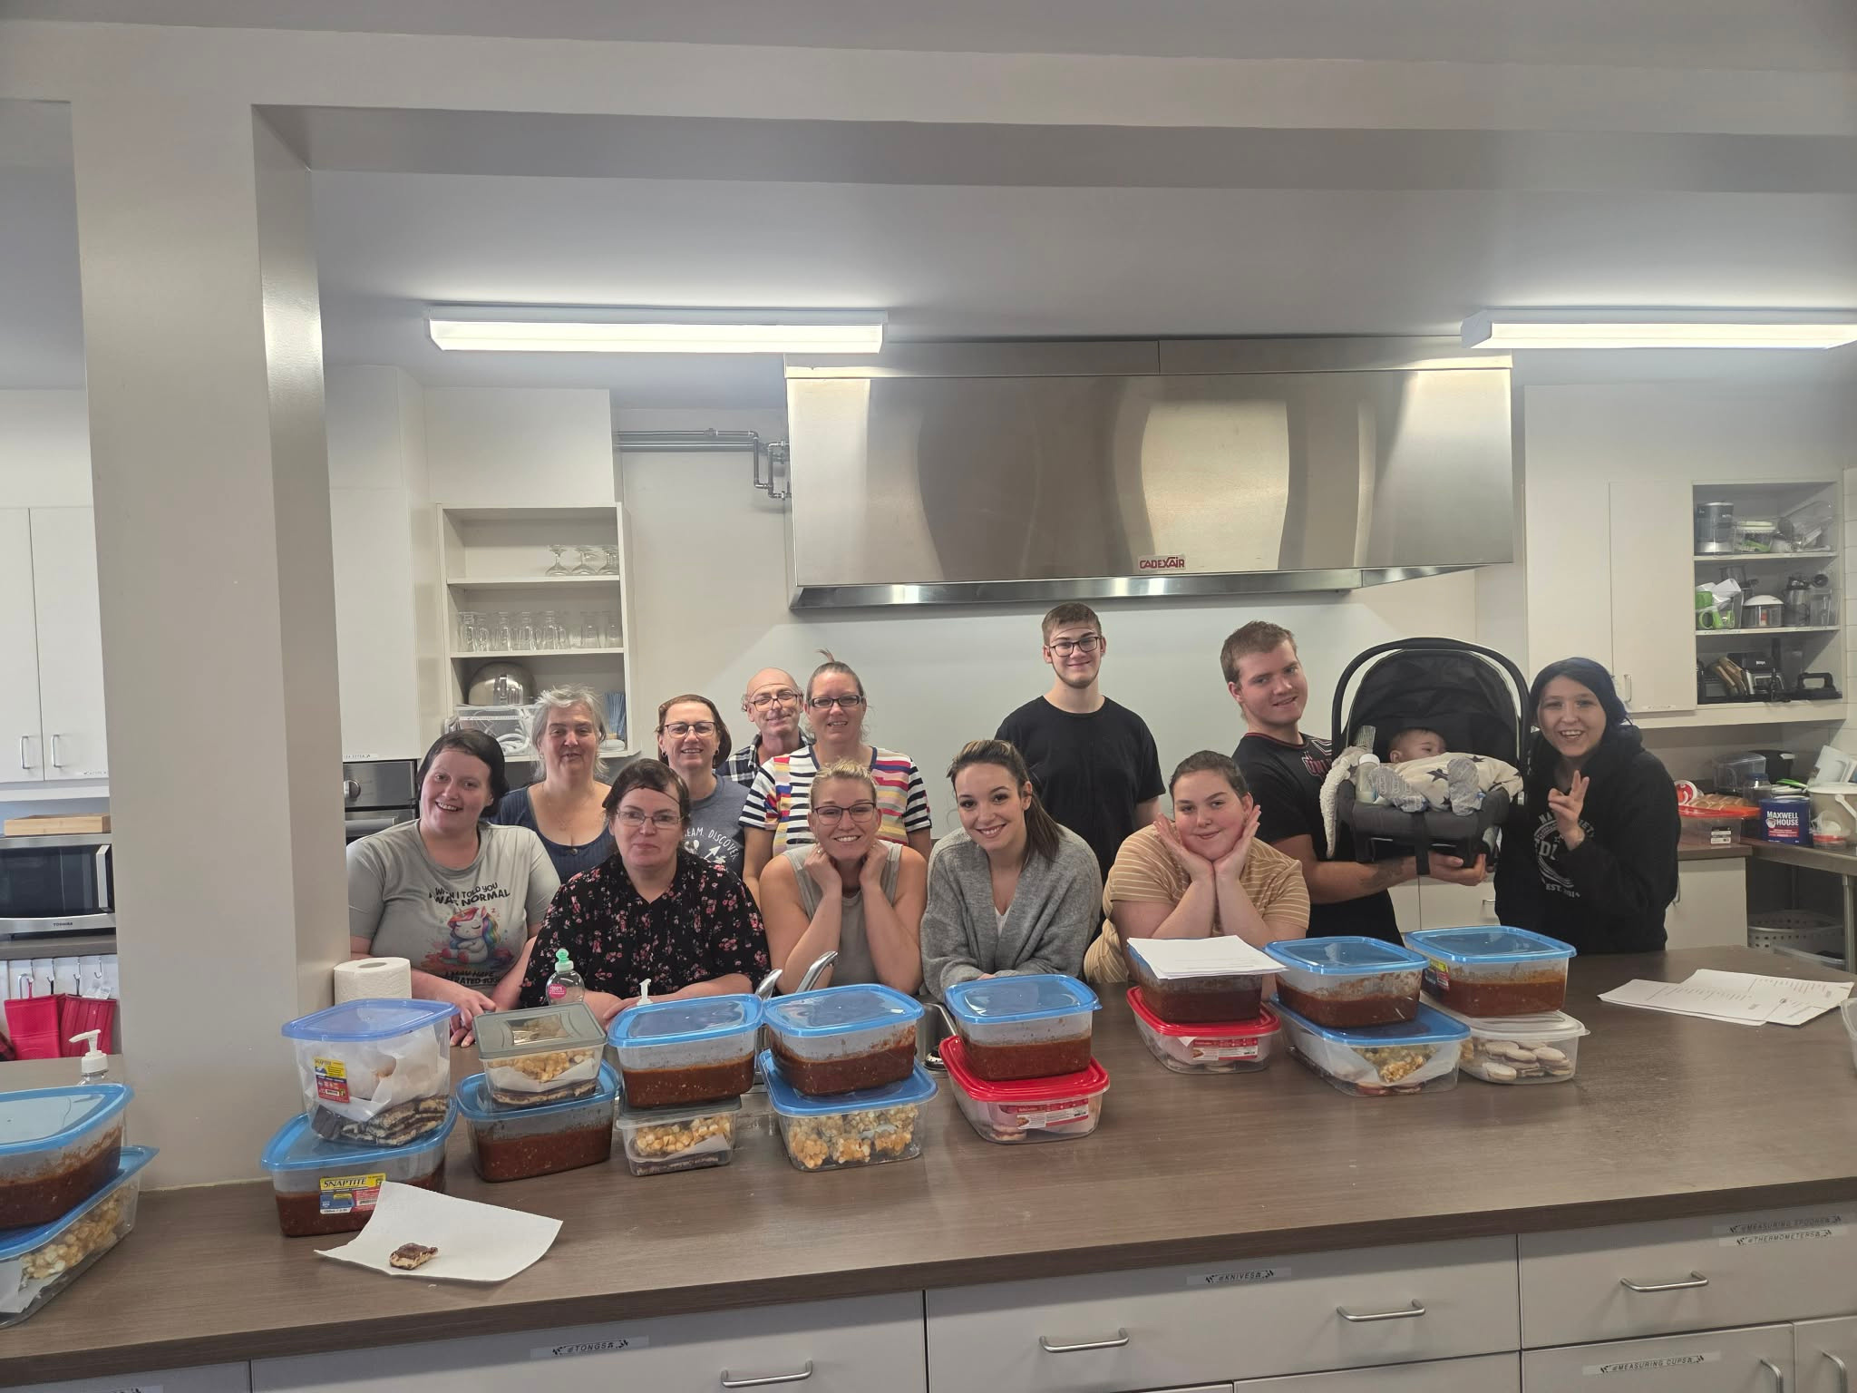
WHO WE SERVE & WHY IT MATTERS
We work with individuals who want to move forward but often face barriers beyond their control.
SOME BARRIERS INCLUDE :
  French language communication
  Transportation and access challenges
  Family and caregiving responsibilities
  Confidence gaps or disrupted education/work histories

Slide 4

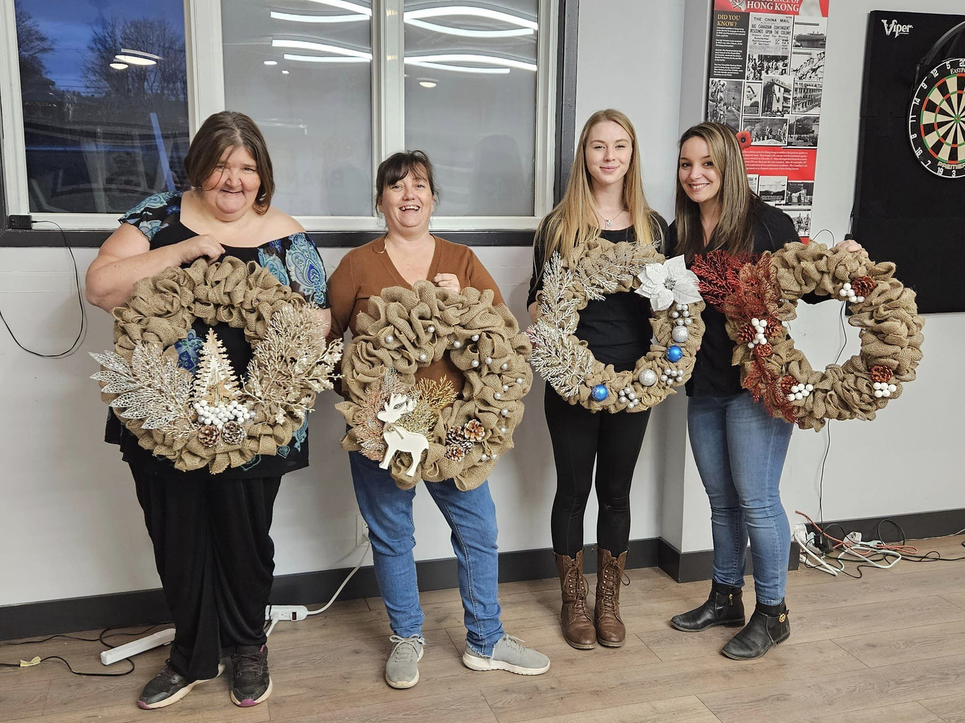
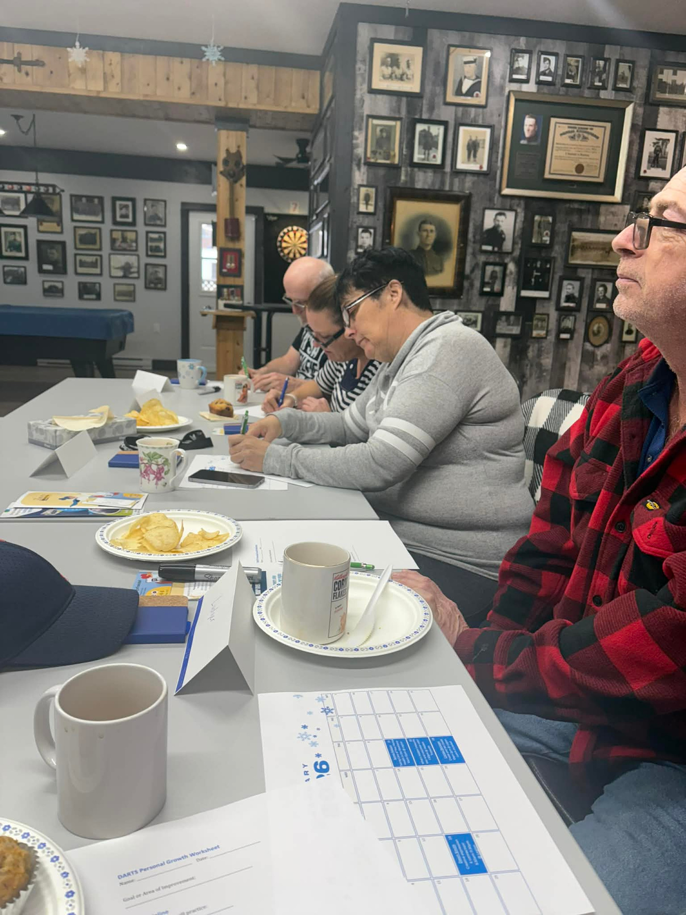
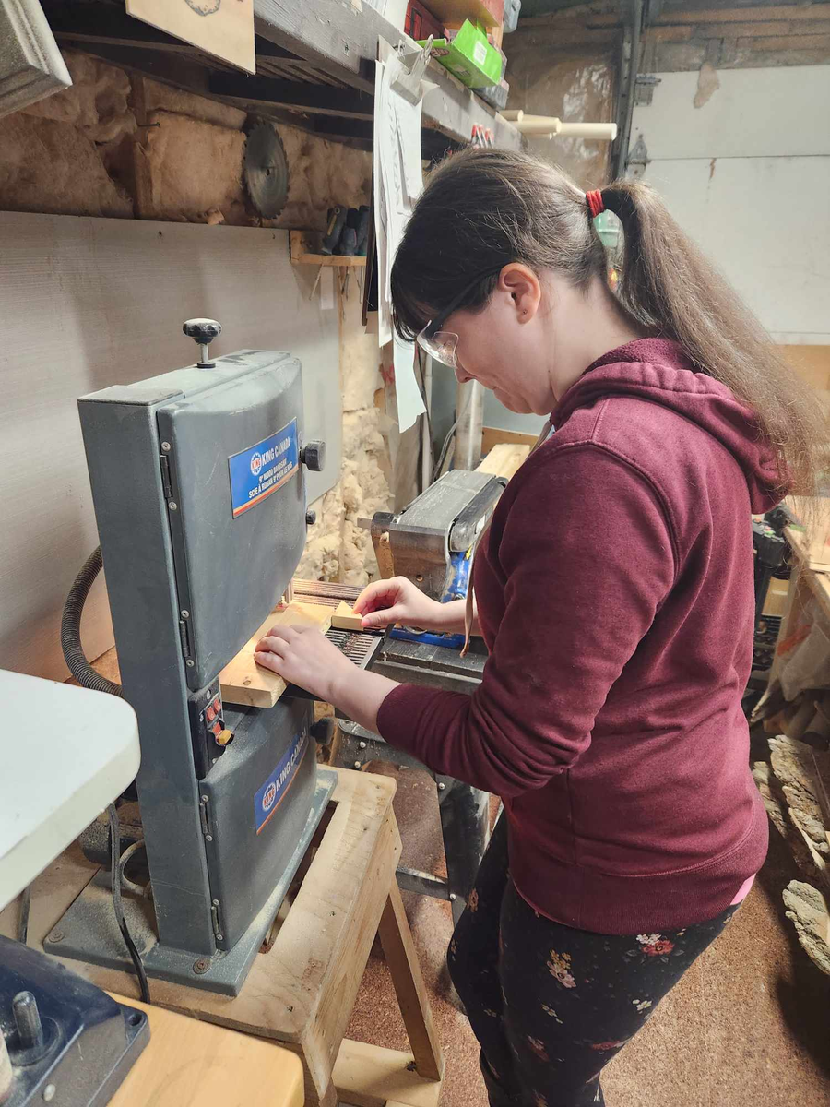
THE GASPÉ COAST REALITY
Programs designed for urban centres don’t always translate to rural and coastal communities.
On the Gaspé Coast, we work with:
  Small, close-knit communities
  Employers with limited HR capacity
  Long distances and limited public transportation
This reality requires flexible, relationship-based approaches.

Slide 5
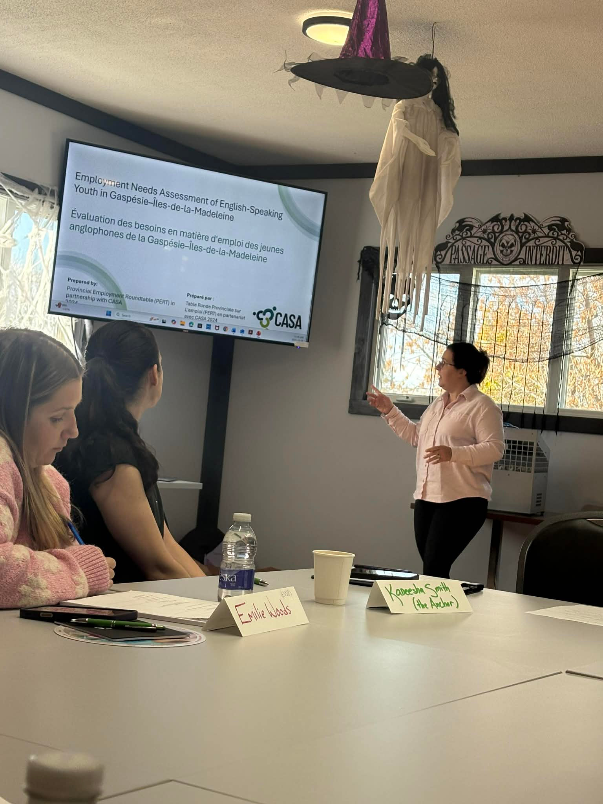

THE DESTINATION U APPROACH
Destination U is built around the belief that people succeed when programs adapt to their lives, not the other way around.
Participant-centred and strengths-based
Flexible, low-barrier access
  OUR APPROACH
Led by local realities
Guided by the Skills for Success framework

Slide 6

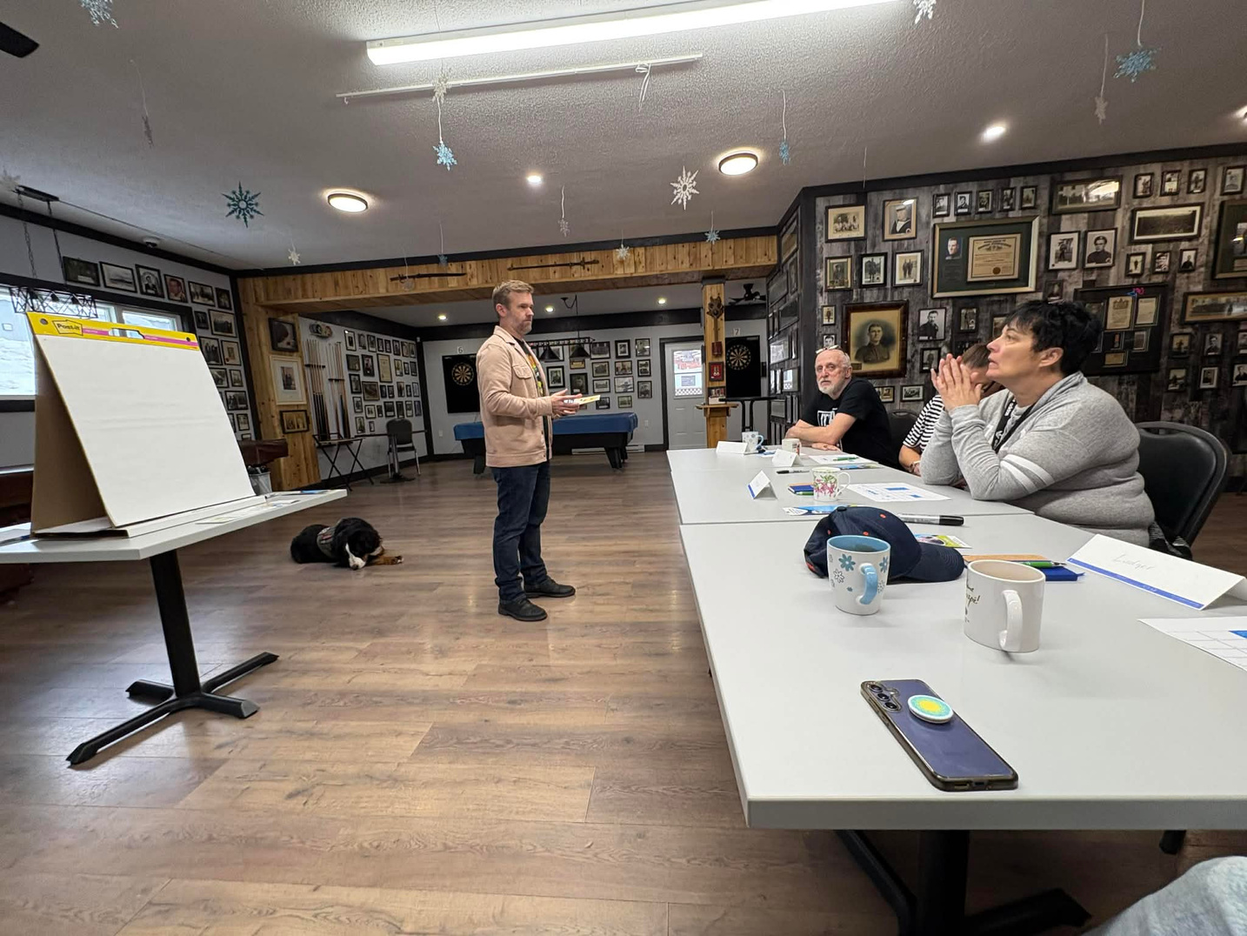
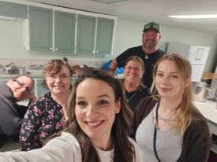
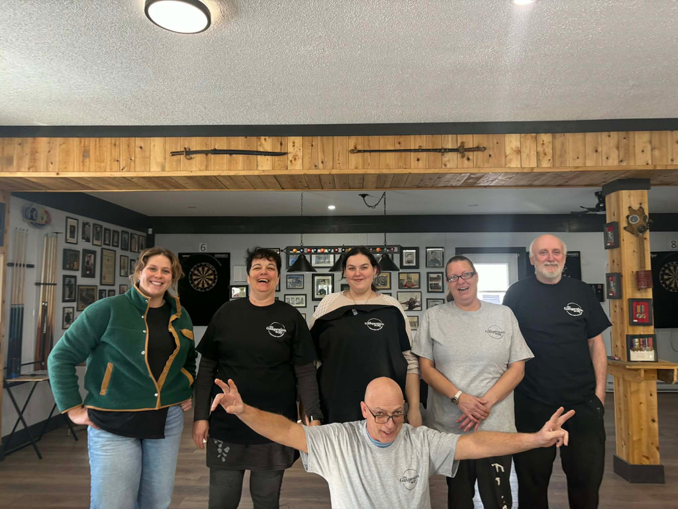
BUILDING CONFIDENCE: FROM ONE-ON-ONE TO GROUP
OUR PROGRESSION MODEL
PEER LEARNING AND MUTUAL SUPPORT
We intentionally start where participants feel safest and build toward community connection.
This approach reduces anxiety, builds confidence, and creates stronger group dynamics.
GROUP WORKSHOPS ONCE PARTICIPANTS FEEL COMFORTABLE AND CONNECTED
GRADUAL TRANSITION INTO SMALL GROUP ACTIVITIES
ONE-ON-ONE MEETINGS TO BUILD TRUST AND UNDERSTAND INDIVIDUAL GOALS

Slide 7

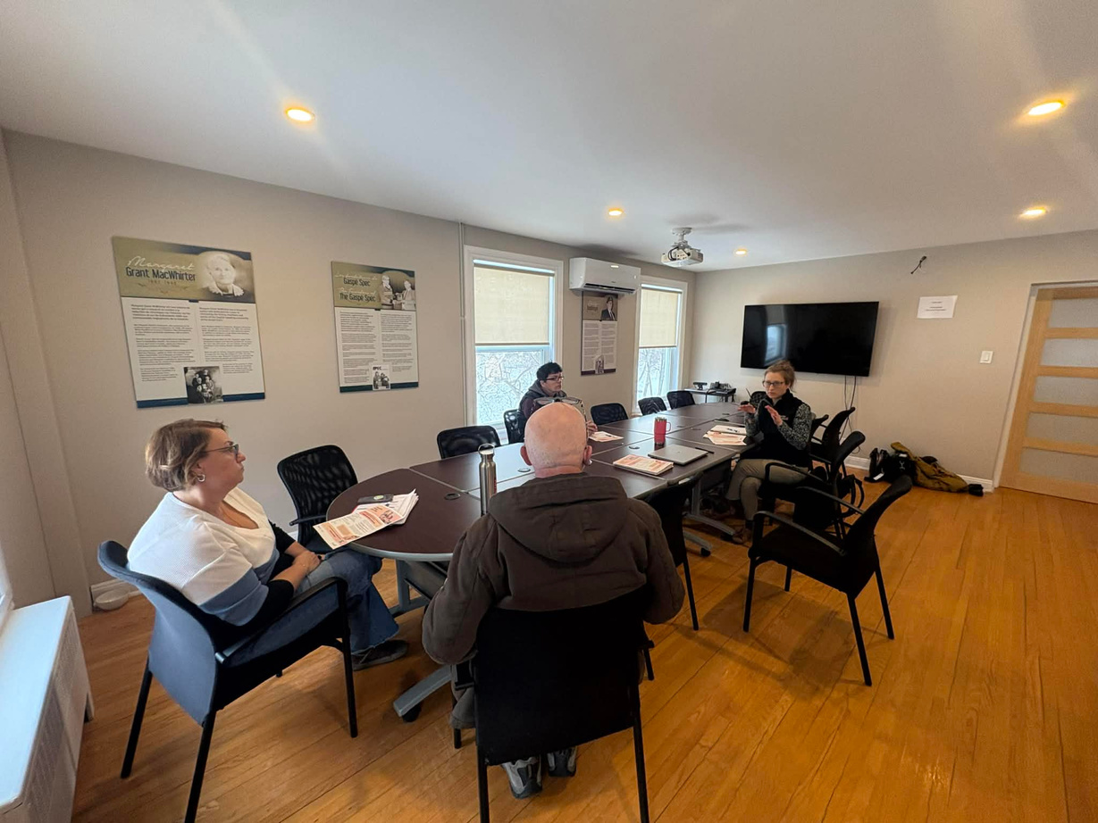
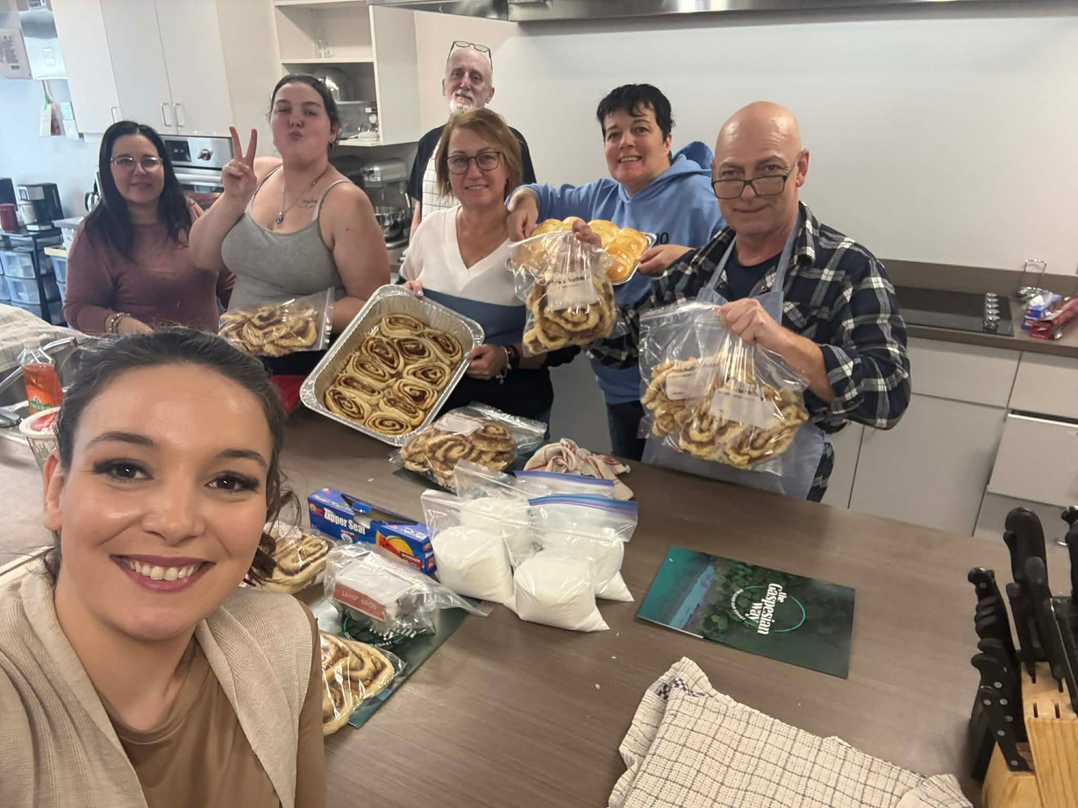
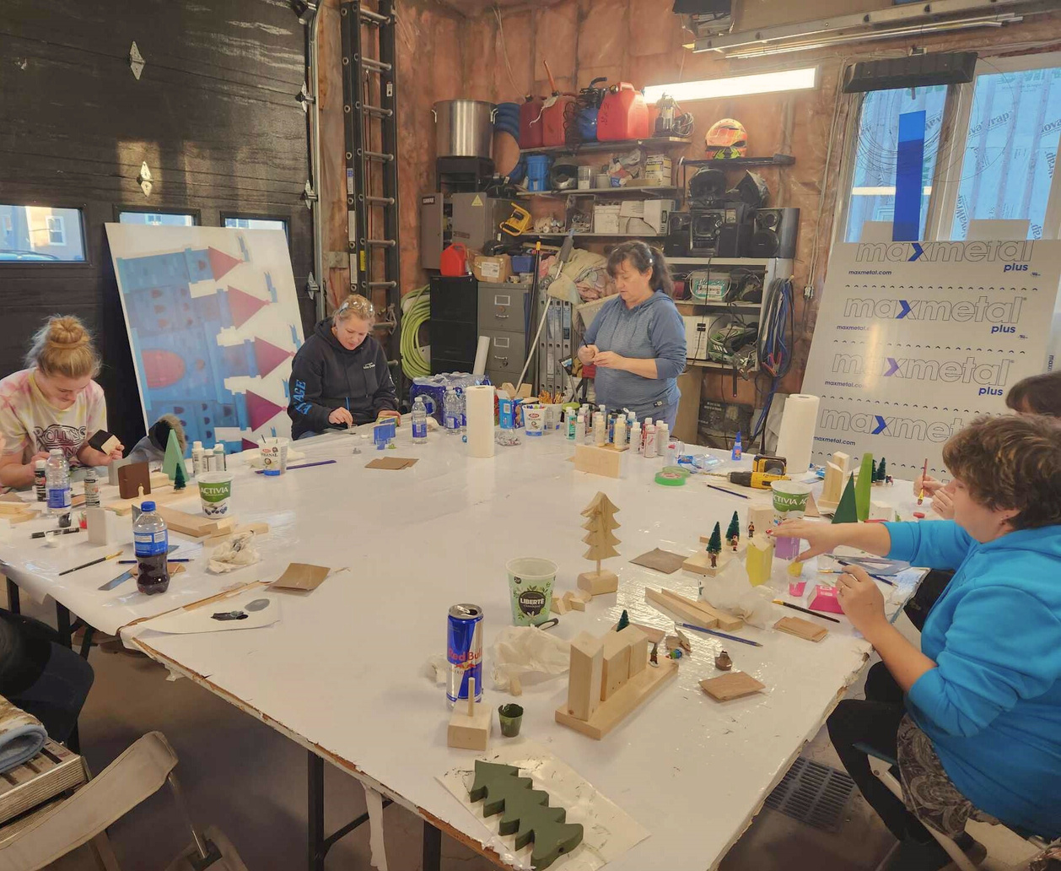
SKILLS FOR SUCCESS IN PRACTICE
WE BUILD SKILLS THROUGH:
ONE-ON-ONE COACHING (COMMUNICATION, PROBLEM-SOLVING)
GROUP WORKSHOPS (COLLABORATION, ADAPTABILITY)
REAL-WORLD EXPERIENCES (DIGITAL SKILLS, CREATIVITY, NUMERACY)
We integrate skill-building into authentic community experiences.

Slide 8

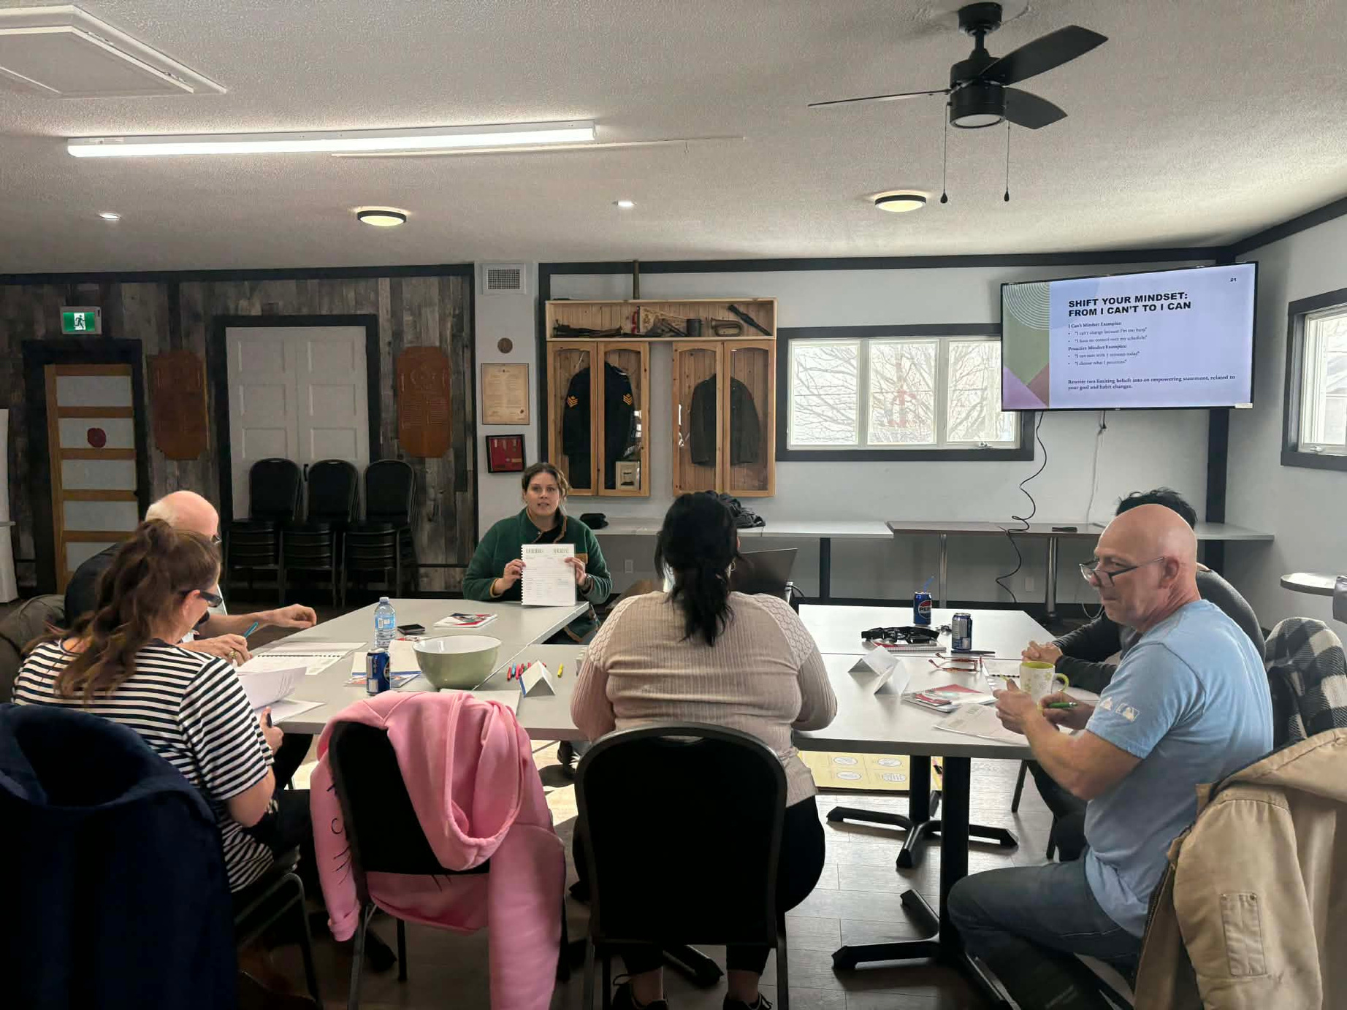
A HOLISTIC APPROACH TO EMPLOYMENT SUCCESS
CAREER GUIDANCE AND COACHING
CHILDCARE-AWARE SCHEDULING
REFERRALS TO WELLNESS AND FAMILY SUPPORTS
SUPPORTING EMPLOYMENT MEANS SUPPORTING THE WHOLE PERSON.
SAFE, WELCOMING LEARNING SPACES
TRANSPORTATION SUPPORT
These supports increase participation, reduce stress, and improve retention.

Slide 9
STRATEGIC PARTNERSHIPS & COMMUNITY COLLABORATION
SOME OF OUR COLLABORATIVE NETWORK INCLUDES:
Through these partnerships, we ensure participants receive integrated supports, streamlined referrals, and direct access to real-world employment opportunities.
  Family Ties
  Centre d’Action Bénévole
  La Passerelle
  Collectif Alimentaire
  Droits et Recours
  Service Canada
  Emploi Québec / Service Québec
  Carrefour Jeunesse-Emploi (CJE)
  Horizon Emploi
  Local school boards and adult education centres
  Regional municipalities and MRC offices
  Local employers across retail, service, trades, and construction sectors
This program is strengthened through coordinated partnerships across employment, education, social services, and the private sector.

Slide 10
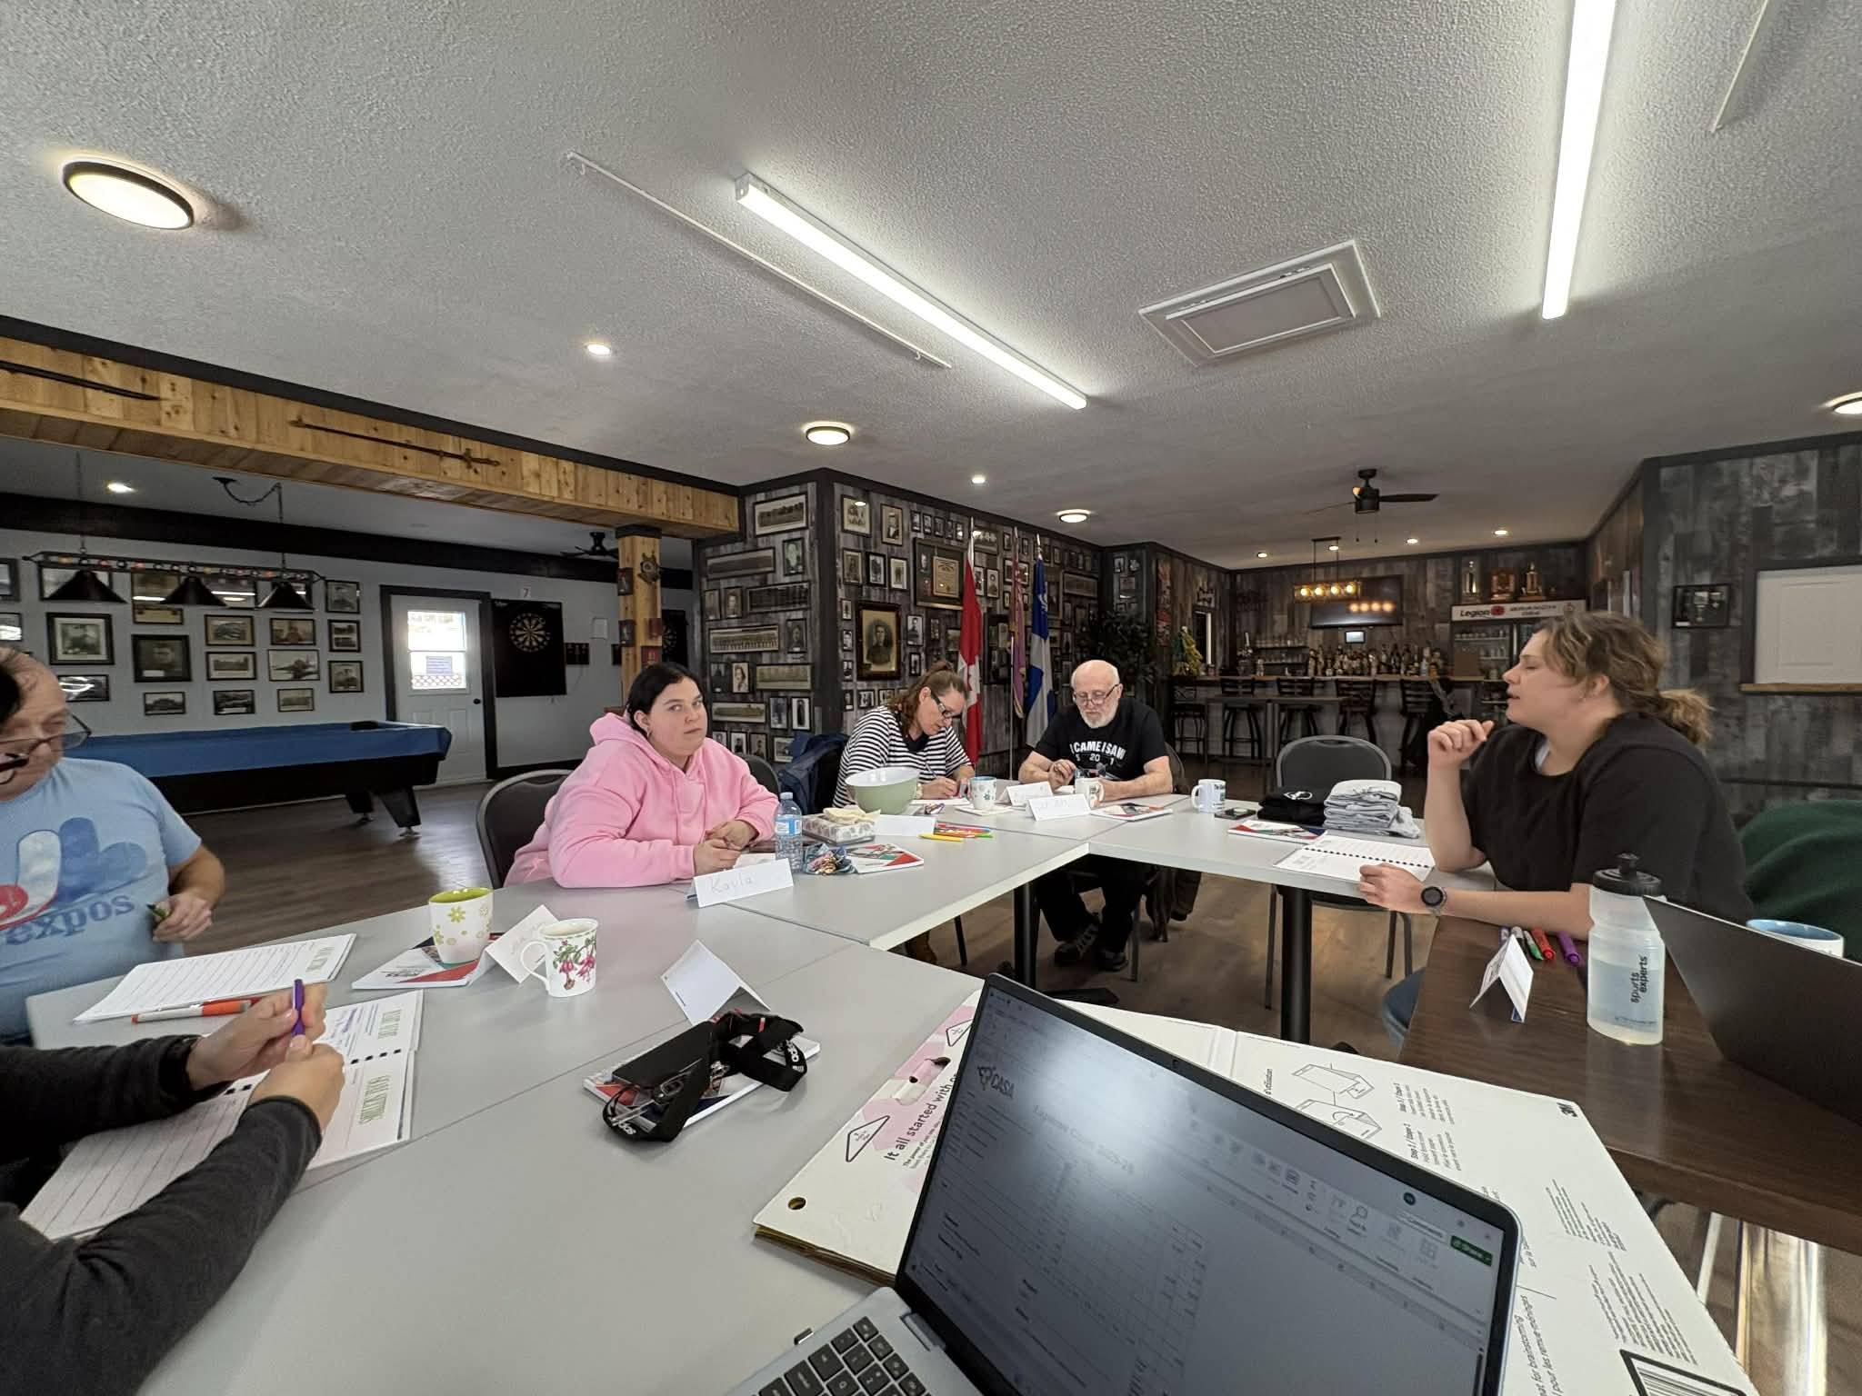
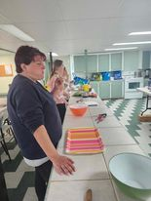

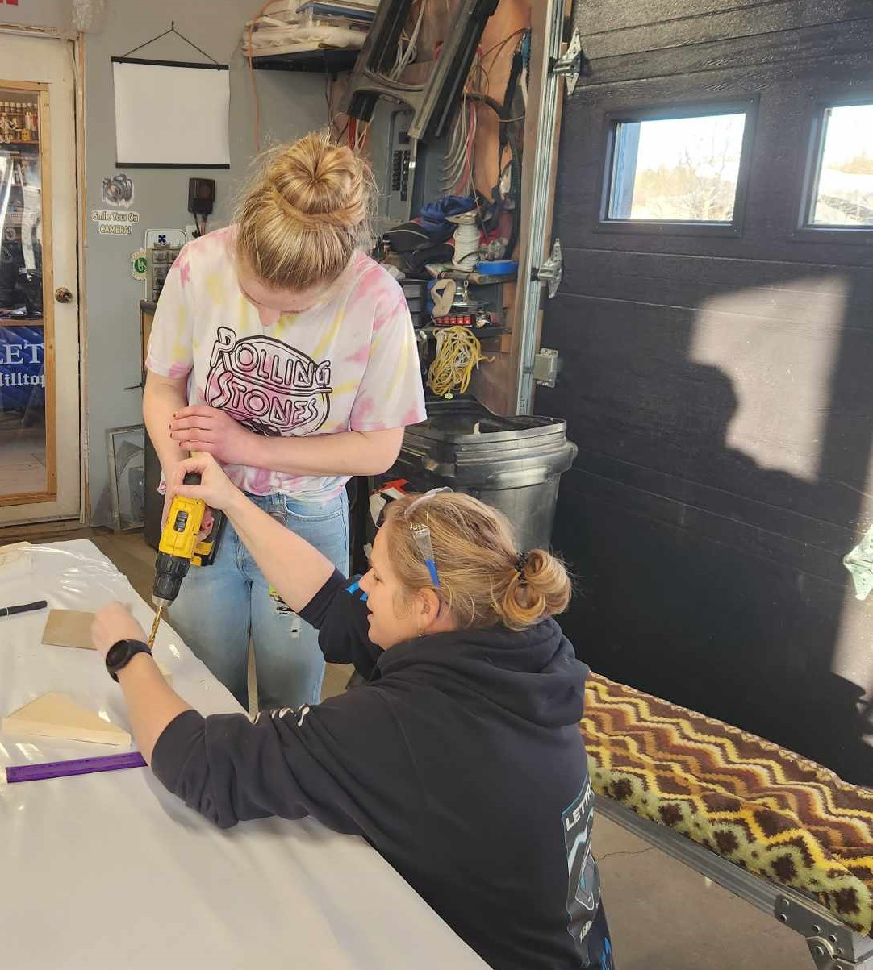
Changes we’ve seen
Challenges
Many anglophone participants face barriers like isolation, low confidence, transportation issues, and limited local job opportunities
Lack of accessible, English-language employability supports on the Gaspé Coast
Participants needing wrap-around support first
Helping people rebuild confidence after long periods out of the workforce
Participants gained confidence, reconnected socially, strengthened essential skills, and began returning to education, training, or employment with renewed belief in themselves.

Slide 11
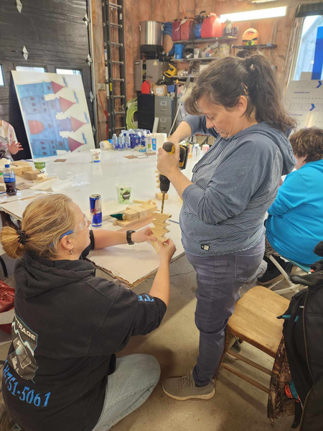
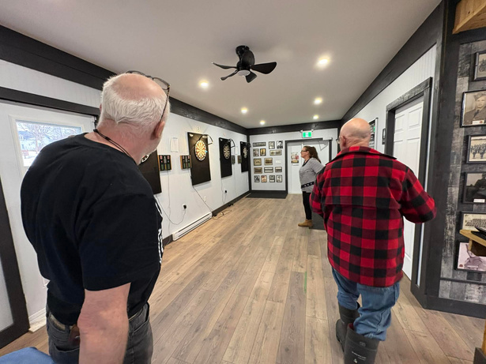
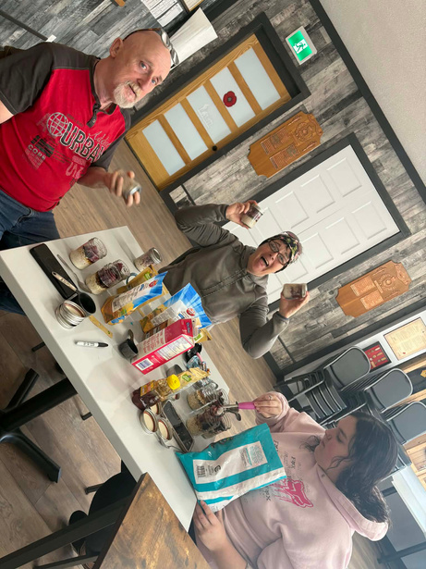
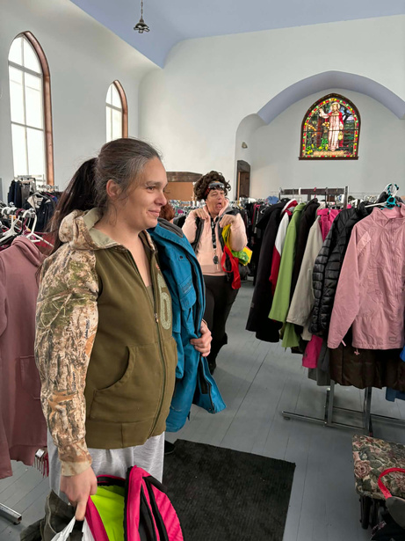
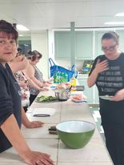
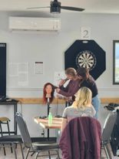
Success Stories
Success Story #1
Success Story #2
Success Story #3
Success Story #4
CAREER DISRUPTION AFTER 20 YEARS IN CONSTRUCTION
SEEKING CONNECTION AND STRUCTURE THROUGH CELI
INCREASED INDEPENDENCE
TURNING HARDSHIP INTO HOPE
Behind every participant is potential, with patience, flexibility, and supportive opportunities, people who have faced barriers can become dedicated, reliable employees and valuable members of the workforce.
Notes:
Success #1 – Christal
One participant joined CELI after we recognized she was becoming increasingly isolated from the community. She did not have a driver’s license, had no employment history, and her only income came from child benefits. She also spoke very little French, which made entering the workforce feel overwhelming.
We began with one-on-one meetings to build trust and understand her goals. Together, we applied for several positions but initially received no callbacks. After two weeks, we followed up in person with local employers. One employer was willing to adapt to her language needs and invited her for an interview.
With permission, we attended the interview to support with translation if needed. She was hired on the spot.
The employer allowed her to complete all computer-based training in English and paired her with a bilingual colleague for on-floor training to help her adjust. From there, her confidence grew quickly.
Today, she is thriving. She communicates confidently in French with clients, is described by management as a strong and reliable employee, and is currently the top seller in workplace promotions. She is eager to continue improving her French and advancing her skills.
Beyond employment, her independence has transformed. She now has her driver’s license, her own vehicle, and her own apartment.
Success Story #2 Ludger
After 20 years working in construction, this 58-year-old participant found himself unexpectedly out of work when his company lost contracts. With no employment and limited savings, he returned to his hometown of New Carlisle to start over.
Despite applying to multiple jobs, his limited French became a significant barrier to employment. Rather than giving up, he chose to take action.
He enrolled in French language classes to strengthen his skills while continuing to attend CELI workshops and remain actively engaged in his job search. Even during difficult days, he stayed positive and committed to improving.
Within two months, his persistence paid off — he secured employment in a French-speaking workplace.
Through determination, skill development, and consistent participation, he demonstrated that growth and adaptability are possible at any stage of life.
Success # 3- Kayla
At just 18 years old, this participant experienced the devastating loss of both parents within six months. Suddenly navigating adulthood while supporting her siblings, she was trying to manage grief, responsibility, and the pressure to generate income.
She joined CELI initially as a way to get out of the house, connect with others, and begin rebuilding structure in her life. Through workshops and one-on-one support, she began identifying her interests and long-term goals.
While working to bring in income, she realized she wanted something more sustainable and meaningful. She identified a gap in her community — no one locally offers massage services — and began exploring how she could build toward that path.
She is now actively developing the foundational skills needed to enroll in an online training program and eventually establish herself in that field. Despite the weight of personal loss and responsibility, she has remained resilient, engaged, and forward-thinking.

Slide 12
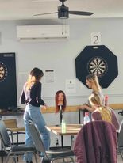
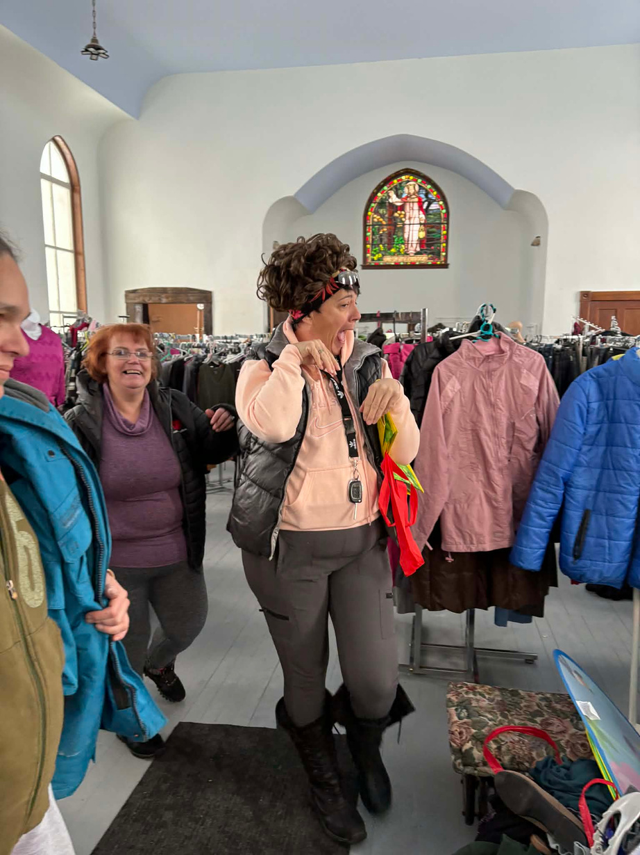

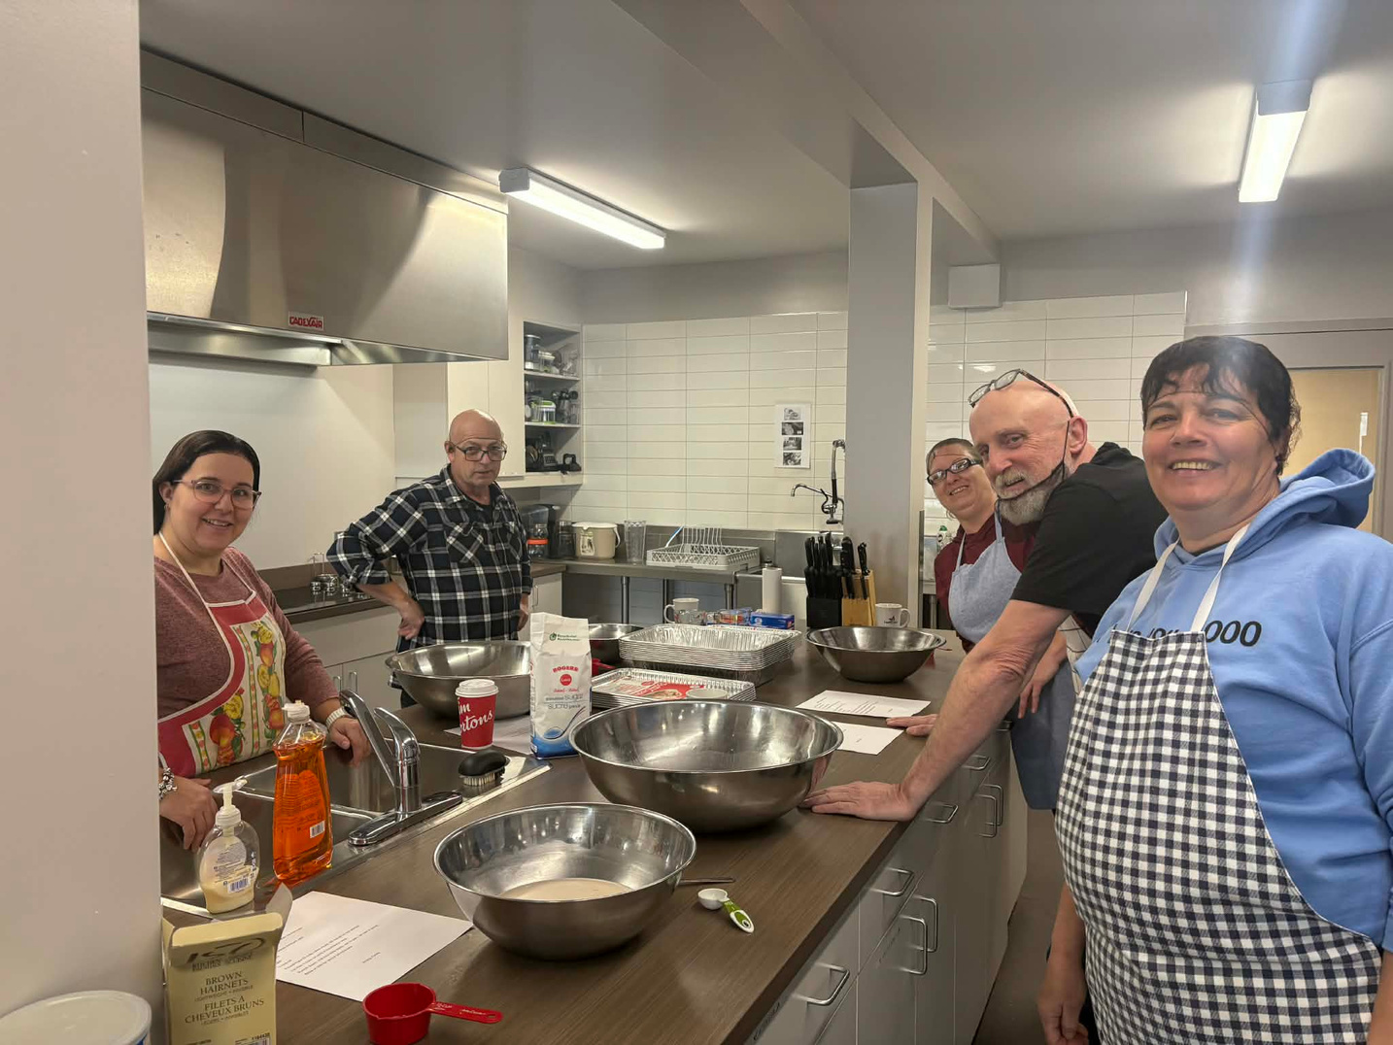
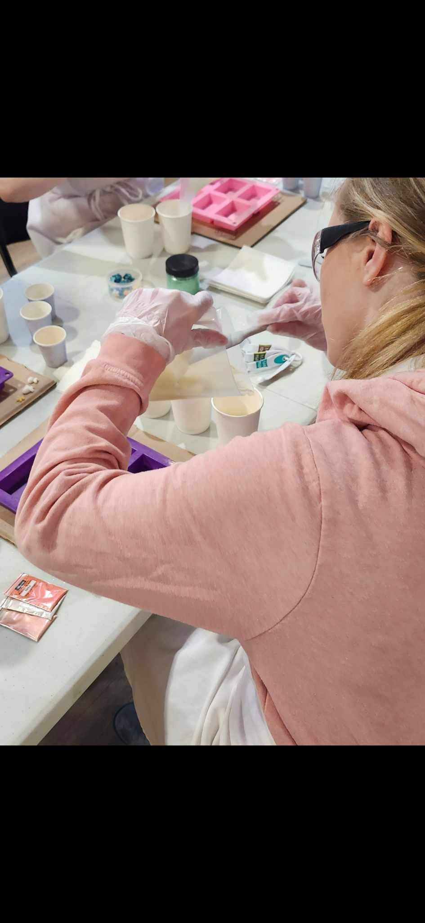
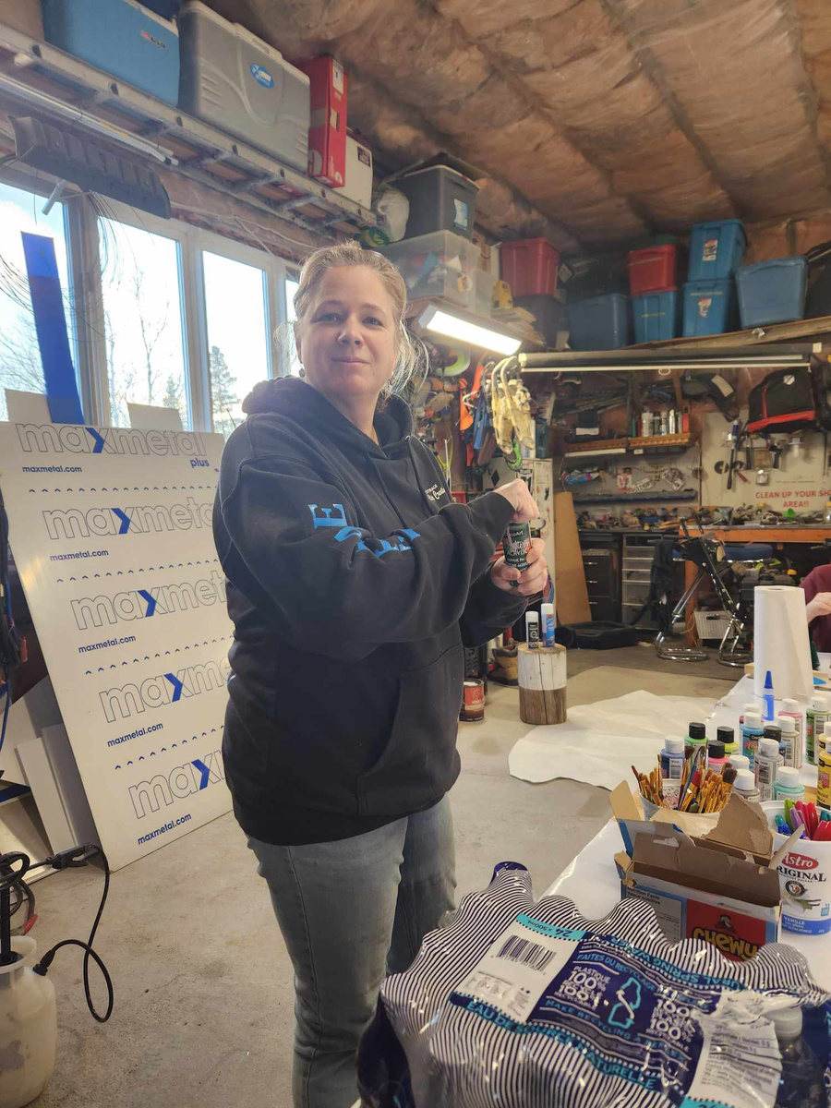
“BEING IN THE CELI GROUP HELPED CHANGE THE WAY I FEEL ABOUT MYSELF BECAUSE OF THE COORDINATOR IN THE PROGRAM WAS EXTREMELY UNDERSTANDING AND KIND”
“WHEN THEY TOLD ME THEY WERE PROUD OF ME, IT MEANT MORE THAN THEY KNOW.”
“BEFORE CELI, I FELT LIKE A LOST A SPARK AFTER MY MOM PASSED AND NOW I FEEL LIKE I GOT THAT SPARK BACK I FEEL THAT PART OF ME AND AGAIN IT’S JUST EASY.”
“ I FELT A FEELING OF PERSONAL CHANGE, ONGOING TRANSFORMATION, AND SELF-IMPROVEMENT.”
Participant Voices
“FEELING SUPPORTED MEANS GREAT CHANGES LIE AHEAD.”
“I FELT SUPPORTED WHEN WE ALL GOT TOGETHER, WE SUPPORT EACH OTHER AND HAVE GREAT JOKES.”
“I FEEL SUPPORTED BY CHANGES IN MY MENTAL HEALTH, PRODUCTIVITY, AND ALSO GOOD HABITS I CAN CREATE DURING THIS PROGRAM.”
“BECAUSE OF CELI I NOW HAVE A DIFFERENT APPROACH TO BE READY FOR THE WORKPLACE, SETTING GOALS AND ORGANIZING MYSELF TO CREATE BETTER HABITS, TECHNIQUES, AND MINDFULNESS”
“THEY HELPED BY BEING UNDERSTANDING AND PUSHING ME TO BE THE BEST VERSION OF MYSELF.”
“REALLY ENJOYED THE GROUP EVERY TIME I GO IT INSPIRES ME TO DO OTHER THINGS AND SO THANKFUL FOR ALL U GUYS FOR ALL U DO FOR US”
“ LOVE IT WHEN WE GET TOGETHER, I REALLY ENJOY MYSELF”

