Slide 1

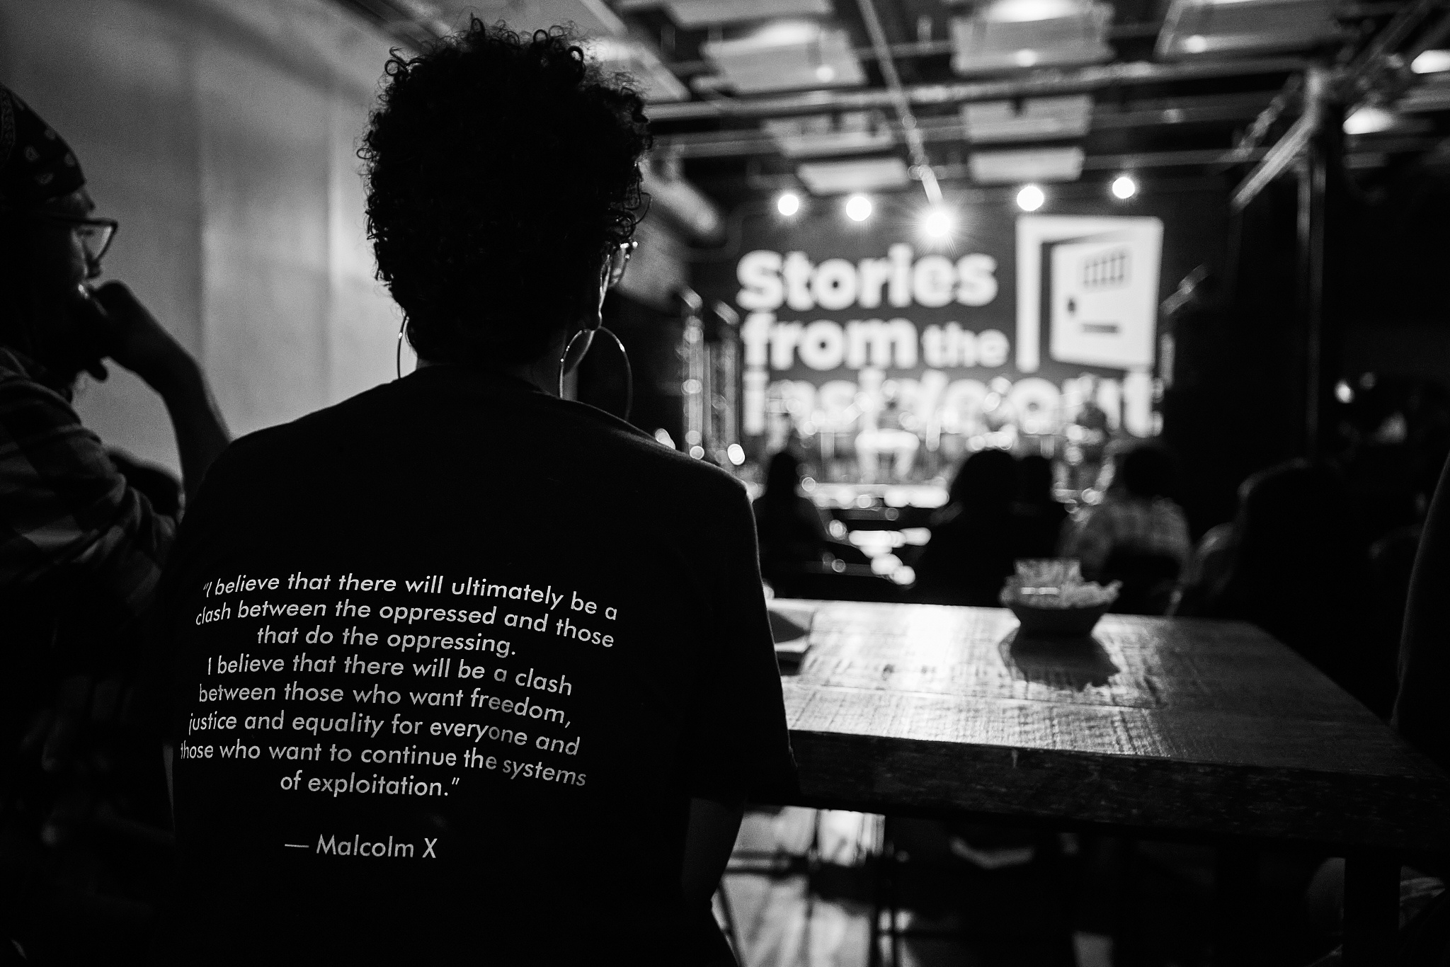

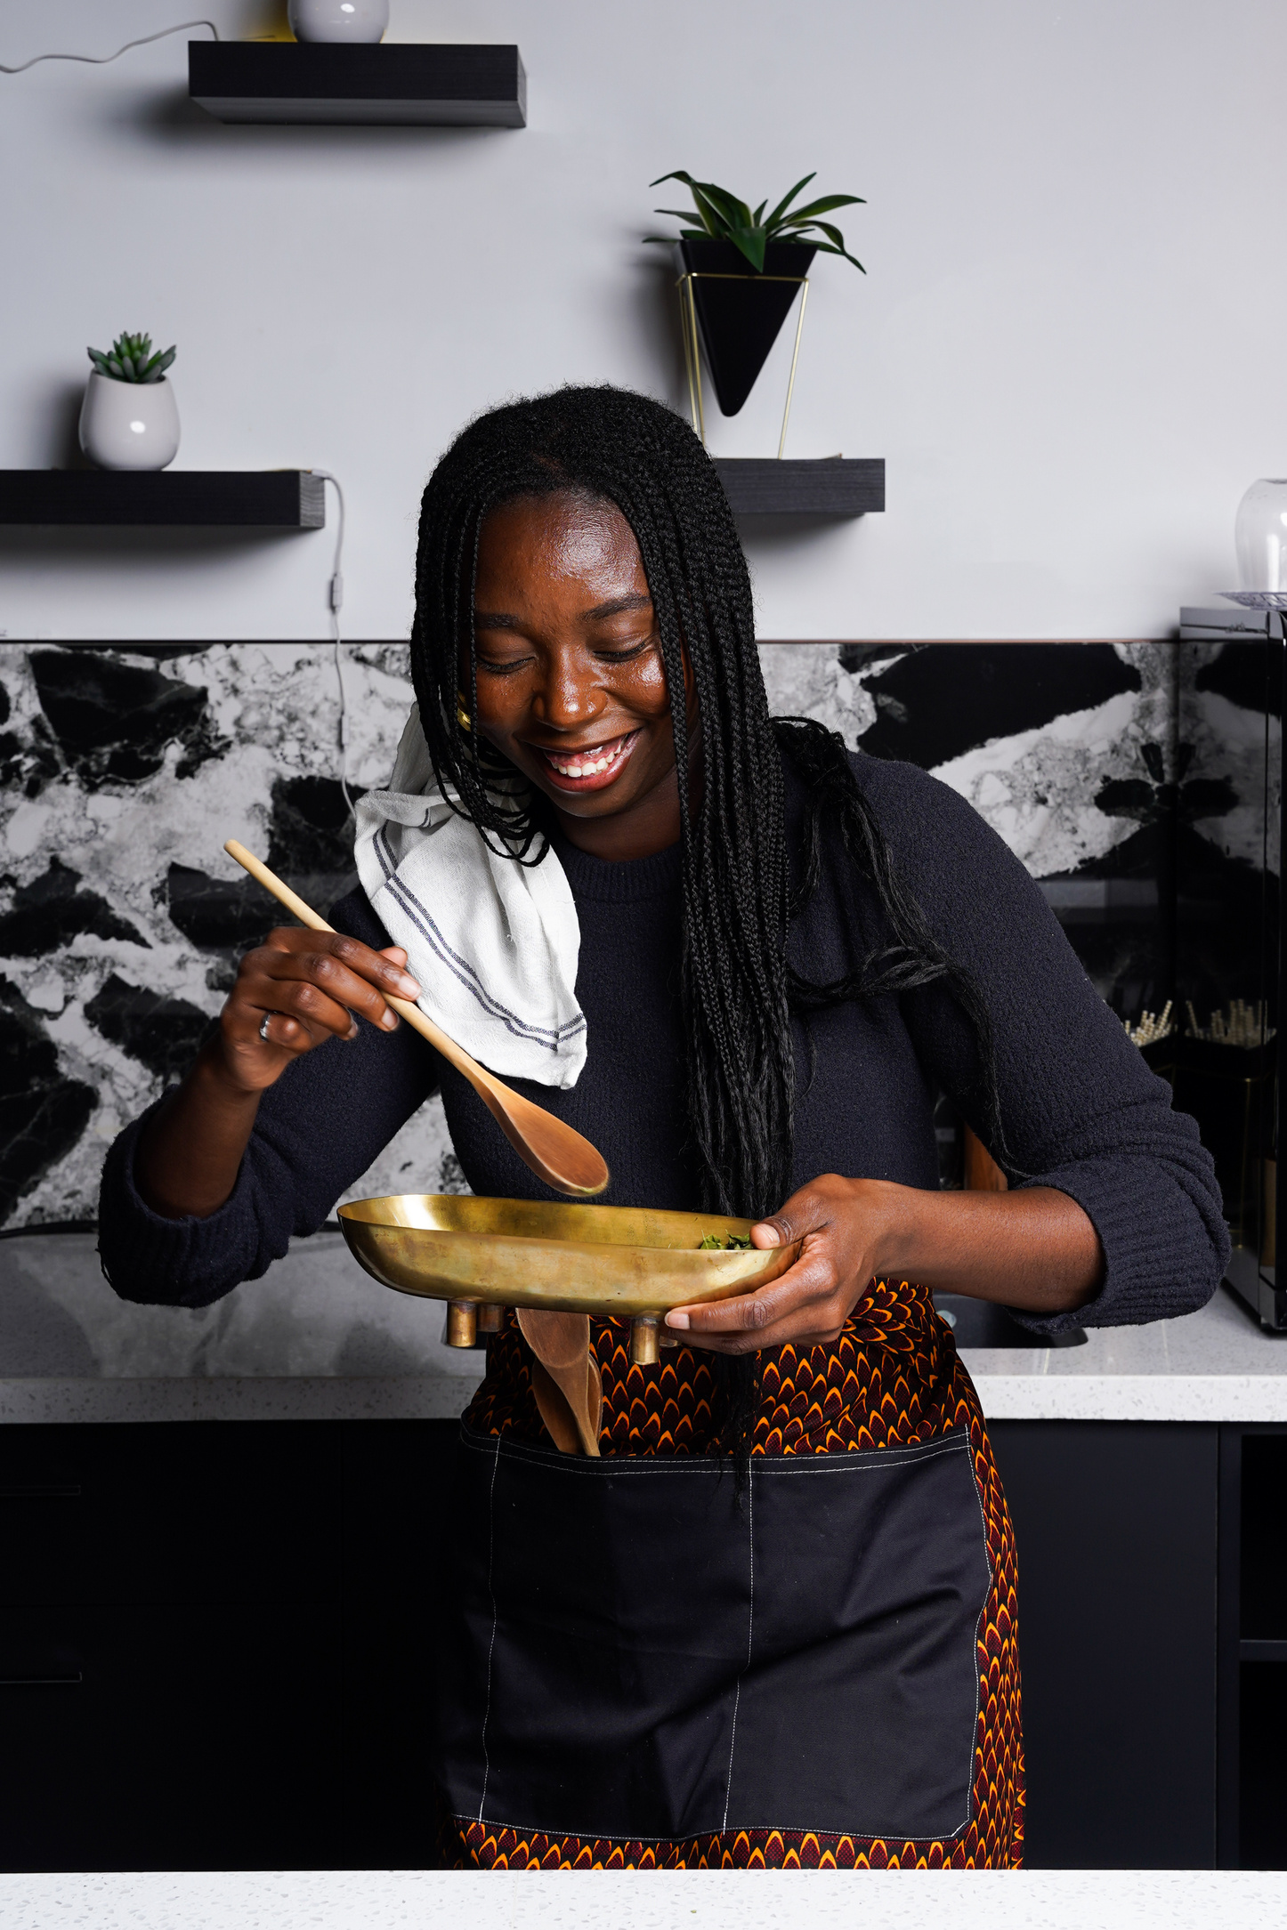
CELI Forum: DESTA Success Story

Slide 2
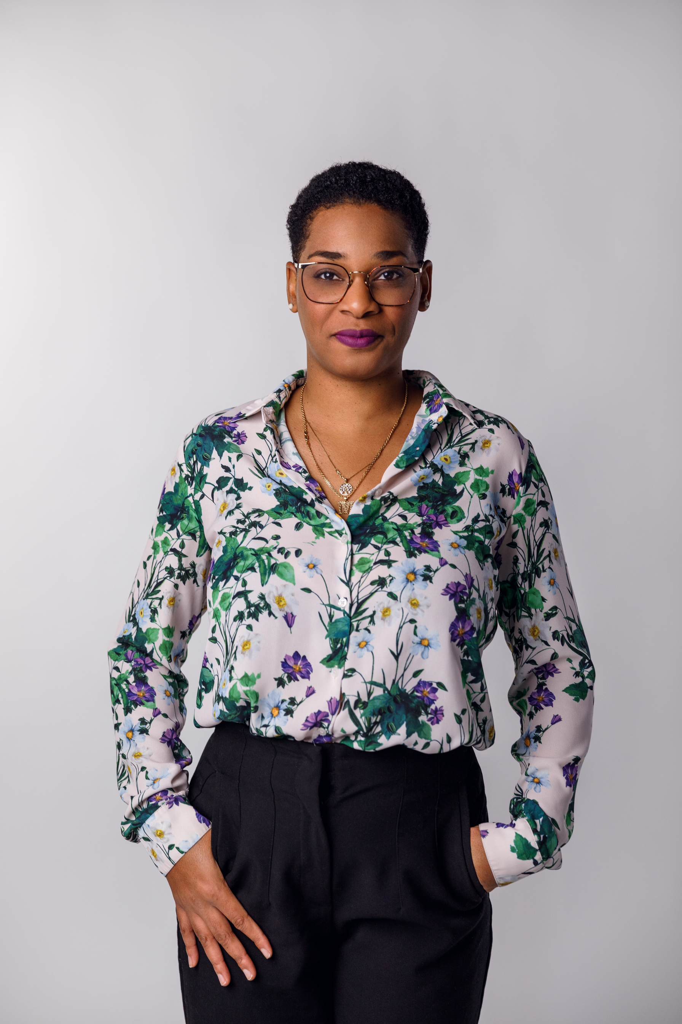
Charline Florestal
Executive Director

Slide 3

Our Mission
Based in Little Burgundy and serving participants across Greater Montreal, DESTA offers access to a hub of services and partnerships that empower the Black community through programs rooted in culture and justice.

Slide 4
DESTA PROGRAMS
JUSTICE
CULTURE
SPECIAL
SERVICE
COUNSELLING
INCUBATOR
CONSULTING
COLLECTIVE
MAISON
ONYX

Slide 5
Our Milestones
Rebuilding With Purpose. Growing With Intention.
2026
2029
Rebuilding trust and reconnecting with donors, partners, and foundations
Re‑establishing our presence and voice after a period of transition
Strengthening our internal systems so our relationships are supported consistently
Clarifying our story and how we show up in the ecosystem
Deepening long‑term partnerships rooted in shared purpose
Expanding our funding ecosystem with clarity and confidence
Building a development engine that is consistent, strategic, and future‑ready
Positioning DESTA as a trusted leader in Justice & Culture.

Slide 6
Organizational Chart
Executive Director
Charline Florestal
Administrative &
Operation Coordinator
Wanda Huskinson
Programs Director
Berlin Reed
Partnership &
Development Manager
Khadijah Banfield
Marketing Manager
Neelam Patel
Justice Re-entry Program
Support Specialist
Amanda Maxwell
Justice Re-entry
Case Manager
Muna Ahmed
Re-entry Social Worker
Olivia Dumas
Culture Program Manager
Courtney Handy
Culture Programming Coordinator
Scott Clyke
Justice Admin Coordinator
Didier Richard Beauharnais

Slide 7
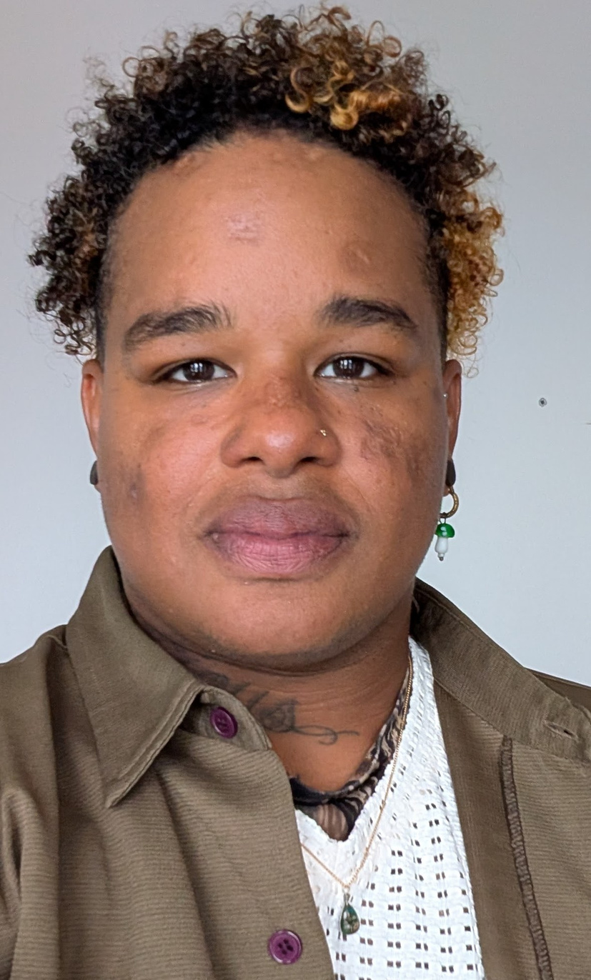
Berlin Reed
Programs Director

Slide 8
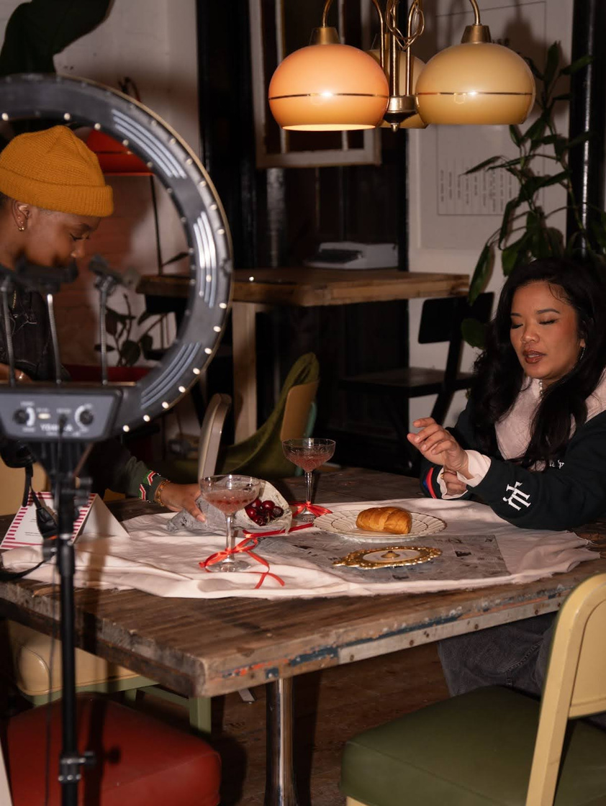
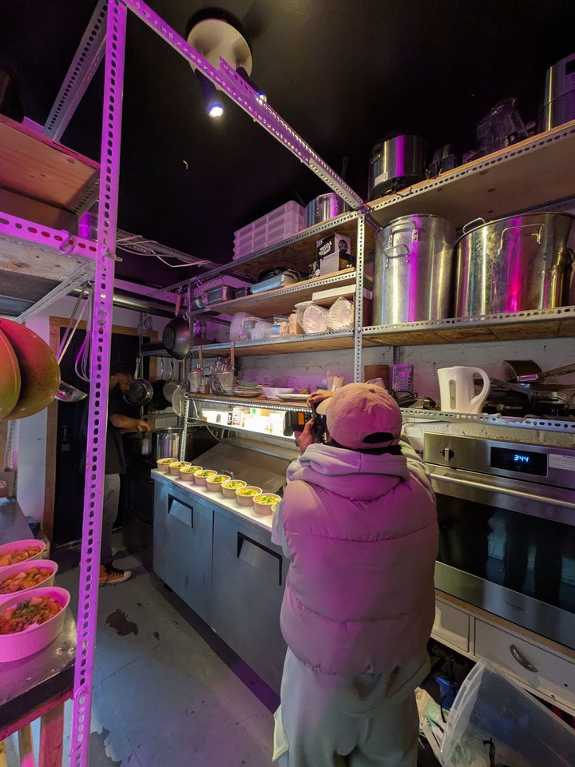
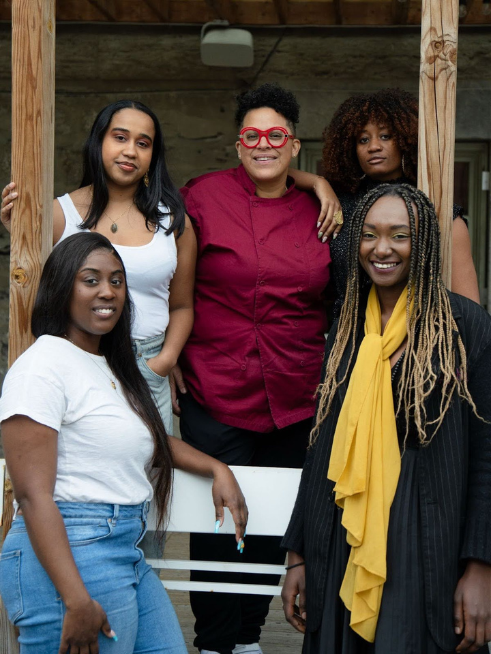
Building Pathways through Justice & Culture - DESTA Programming
DESTA Justice challenges the past by prioritizing dignity, respect and a trauma-informed perspective to provide currently and formerly incarcerated individuals with access to critical information and legal resources. We seek to return people to their families and communities through advocacy and individualized services including support with parole and sentencing, employment, housing, legal assistance, and personal development.
DESTA Culture works toward the future by building
a strong ecosystem of Black cultural expertise and collaborative platforms for growth and representation. Through free public programming and our Culture Incubator - composed of cultural professionals
from arts, media, and food sectors- we support
Black creativity as a source of inspiration and economic opportunity, nourishing local businesses while grounding Black entrepreneurship in direct community action.

Slide 9
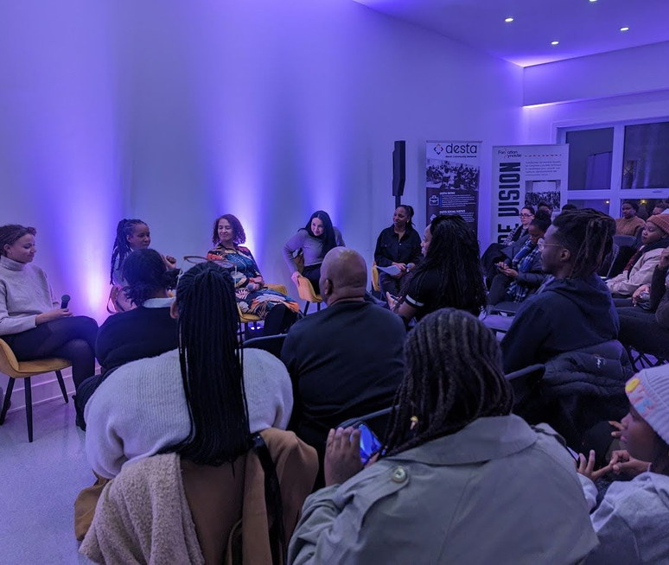
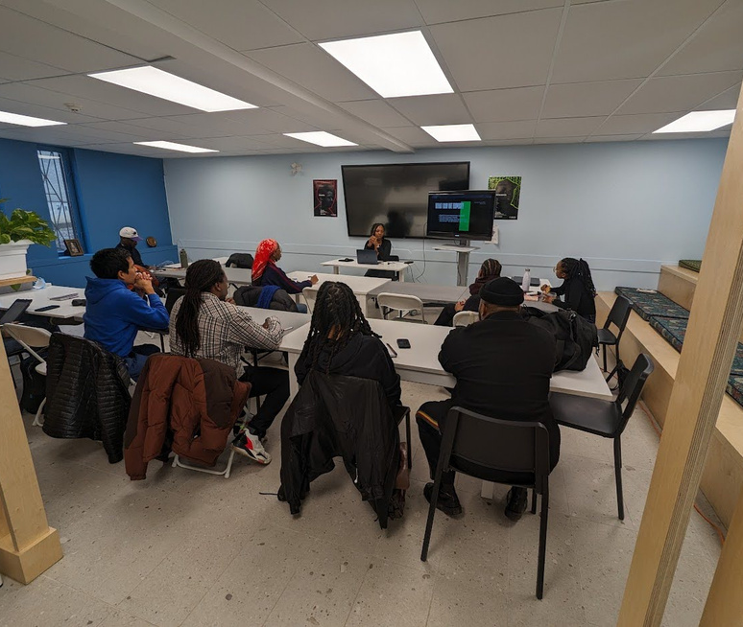
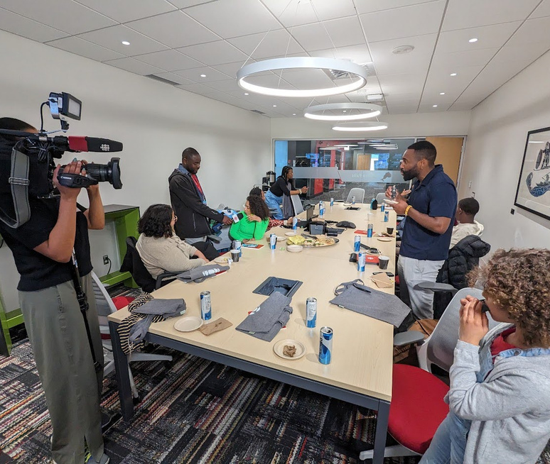
CELI Projects
November 2023 - The Conversation Continues: Perspectives in the Creative Industry
March 2024 - Introduction to Film Production Financing
April 2024 - Paths to a Career
in Broadcasting
Series with Tracy Paulotte of Fondation Dynastie
CBC journalists host youth for full day
tour and discussions at CBC Montreal
A panel of Black women and women
of color in film

Slide 10
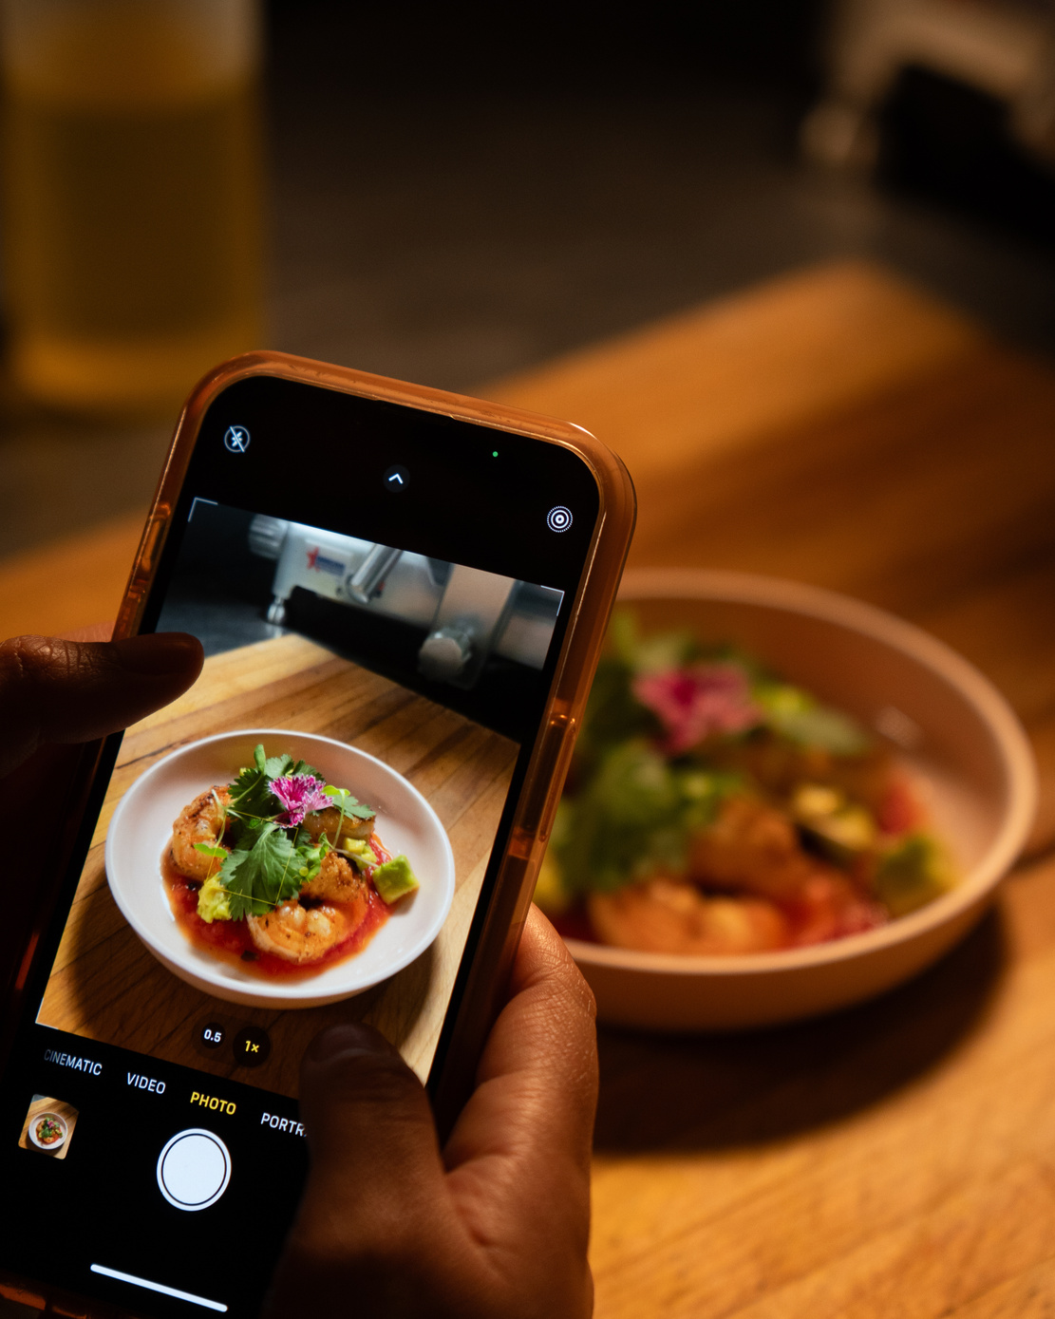
Lasting Impact on DESTA Culture
Our Culture Incubator expansion was motivated by the response to these workshops, taking the scope from the food industry to the arts and media world as we celebrate 5 years in operation and prepare for the 7th cohort.
Building a rich future through supporting young entrepreneurs in cultural production sectors.
Weaving together business development, mentoring with active industry professionals, subsidized professional services, paid production contracts, and access to commercial facilities and specialized tools.
Guiding the community to resources through ONYX Lab cultural programming, produced by current and alumni members, breaking barriers to access and prioritizing open knowledge sharing with the public.

Slide 11
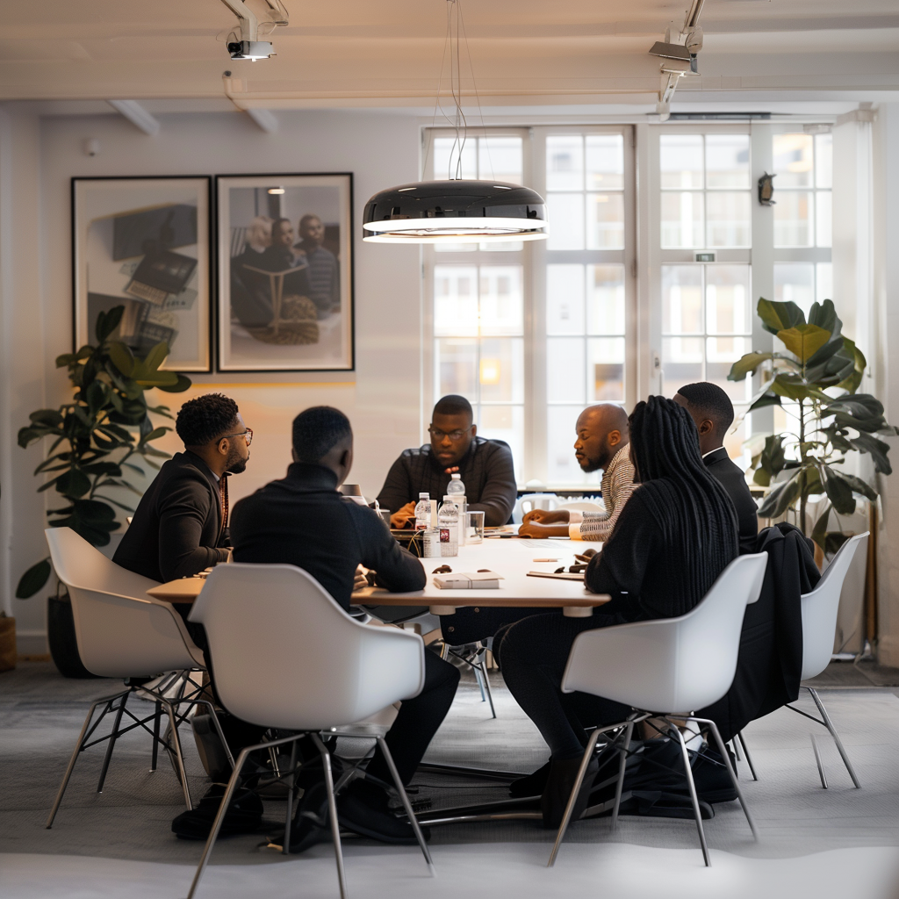
Let’s Connect
Hello@destabyn.org
www.destabyn.org
(514) 664-5042

